Slide 1

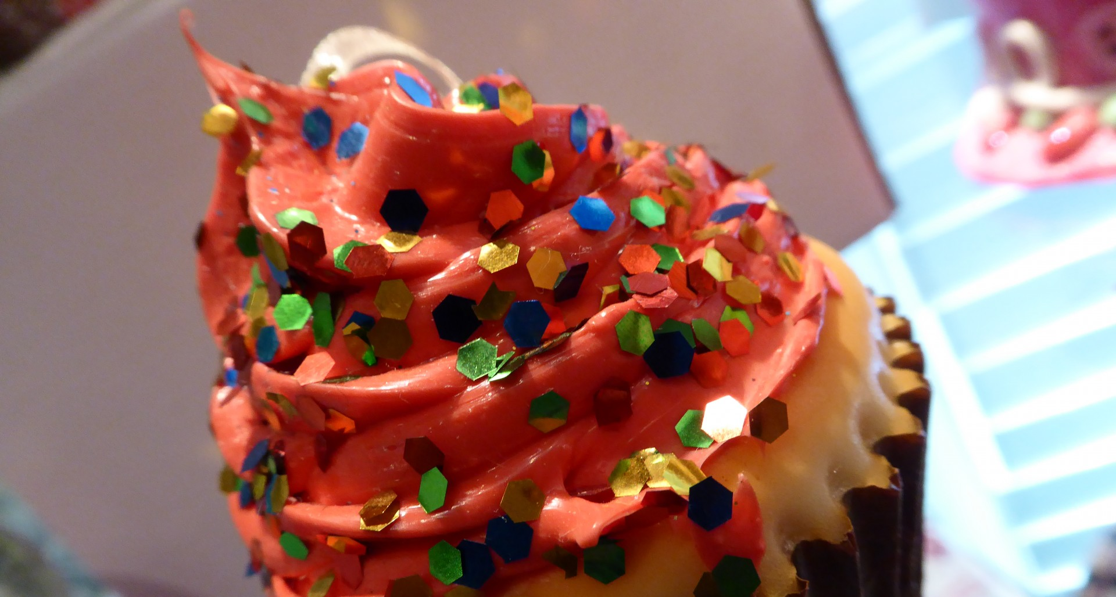
Award for best advisor on selfcare and expert cake eater…
This Photo by Unknown Author is licensed under CC BY-NC-ND

Slide 2


Award for best funny one liner and artist…

Slide 3


Award for best tech queen and baking disaster..
This Photo by Unknown Author is licensed under CC BY-NC-ND

Slide 4
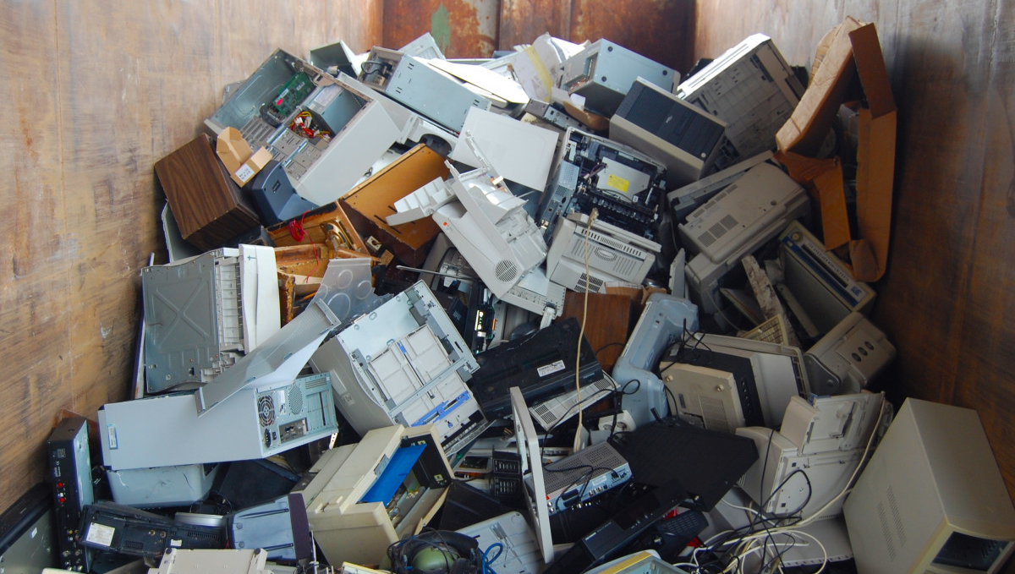

Award for coping best with tech nightmares and being silent but deadly!
This Photo by Unknown Author is licensed under CC BY-NC

